Slide 1




WOMEN IN
TURKISH ARMED FORCES
Gizem SOMUNCU
CIV. SME
International Operations Specialist

Slide 2
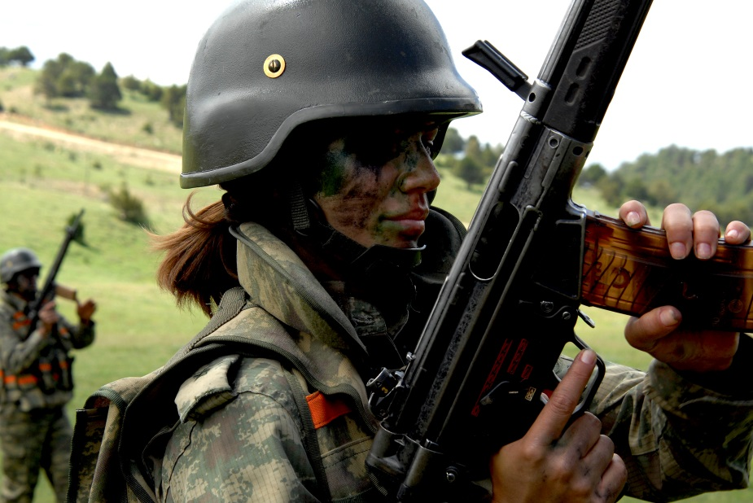
AGENDA
Recruitment & employment
Career development opportunities
Main policies & practices regarding the female personnel
International Peacekeeping Operations & NATO missions
Gender Perspective in Turkish Armed Forces (TAF)

Slide 3
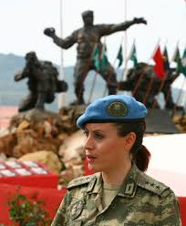
Recruitment & Employment
In TAF, types of service differ for men and women.
A) Obligatory military service: Only for male citizens who are 20 and above.
B) Employment as military personnel: The same standards apply for both male and female citizens. This is a professionally-based service, unlike Type A, which recruits male civilians for basic training for a limited time only.

Slide 4
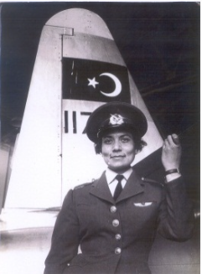
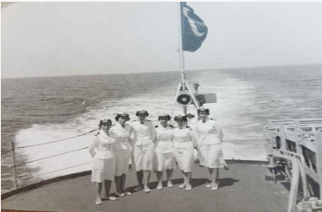
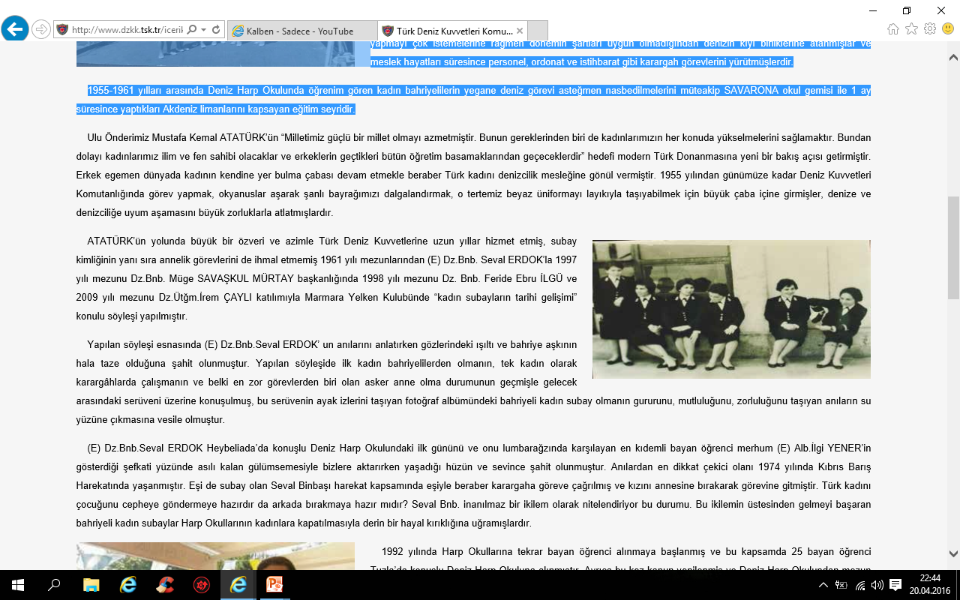
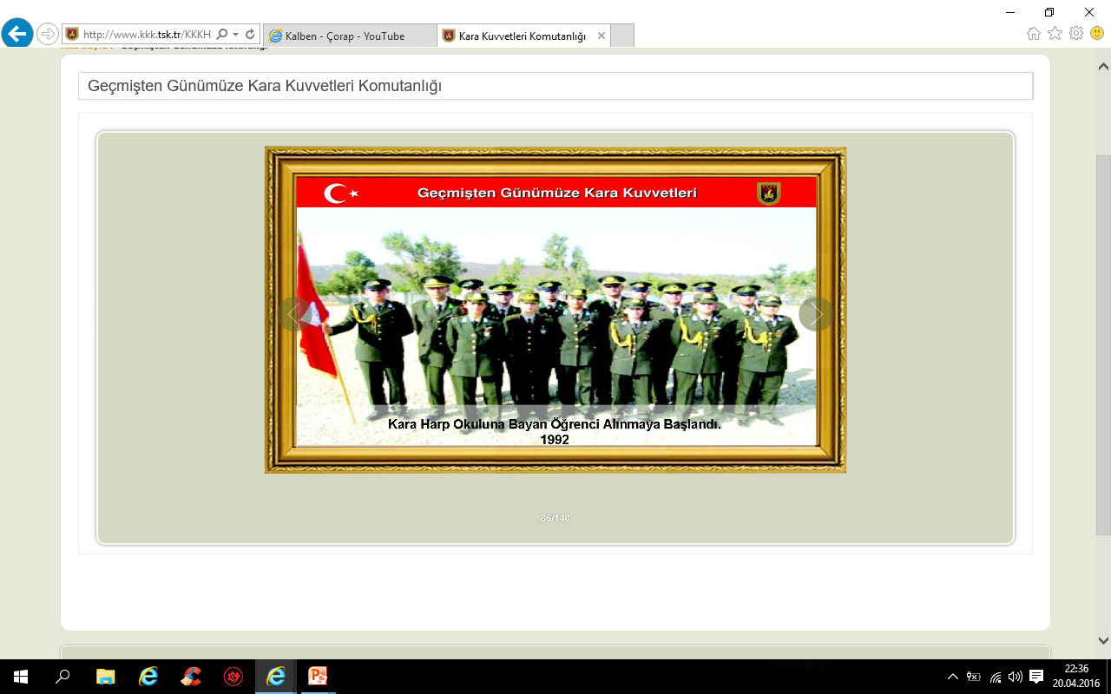
Historical Roots of Female Recruitment in TAF
1955 – first female cadets in each of the war colleges
1957 – first female jet pilot graduated
1959 – first female graduates of the Naval War College
1955 – 1960 – 24 female cadets in Air Force War Colleges
1992 – female recruitment started again / most are colonels now

Slide 5
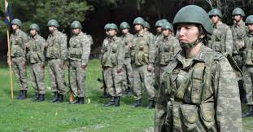
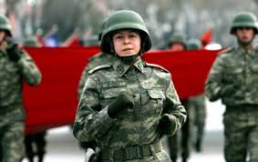
Types of employment in TAF
All personnel
Officers
Civil servants
NCOs
(non-commissioned officers)

Slide 6
Sources of employment
Officers
Regular
(from Military Academies or Civil Universities)
Contracted
(from Civil Universities)
NCOs
Contracted
(from Civil High Schools or Civil Universities)
Civilians
Regular
(from Civil Universities)
Contracted
(from Civil Universities)

Slide 7
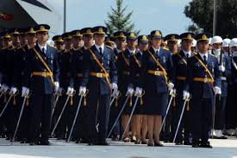
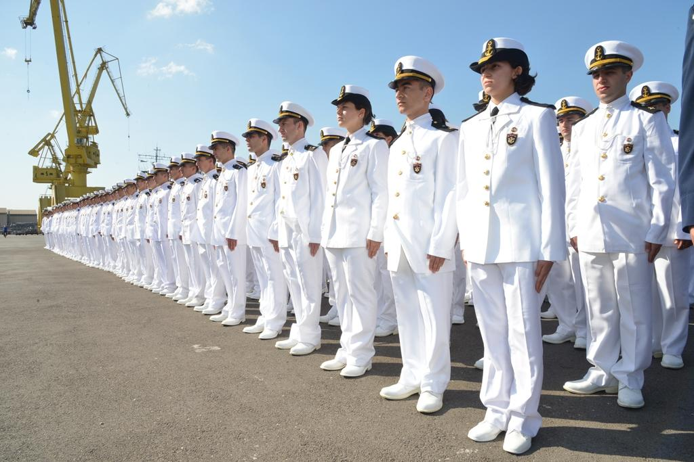
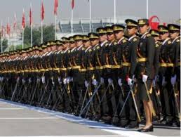
Classification system
Allows the personnel to be distributed to relevant branches, depending on
their area of expertise and previous employment experiences,
their individual preferences,
their physical and intellectual capabilities, skills and talents, education levels, interests, and personal profiles,
AND
the personnel
needs of the institution.

Slide 8
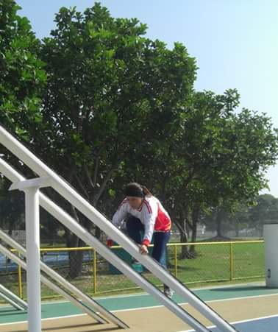
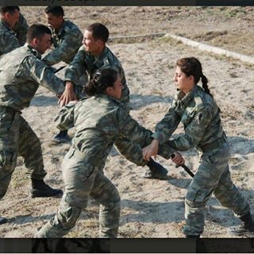
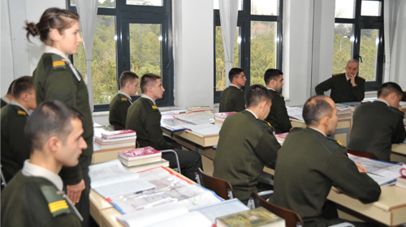
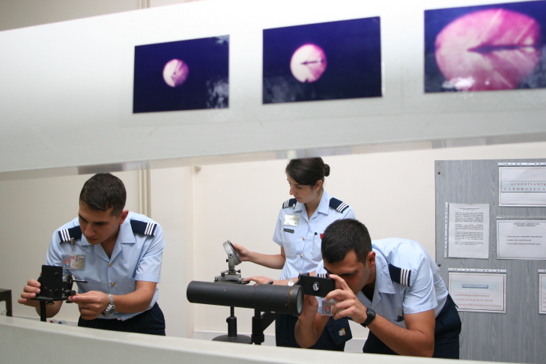
Training
For officers and NCOs,
Military academies and schools
For civilians,
Basic institutional courses

Slide 9
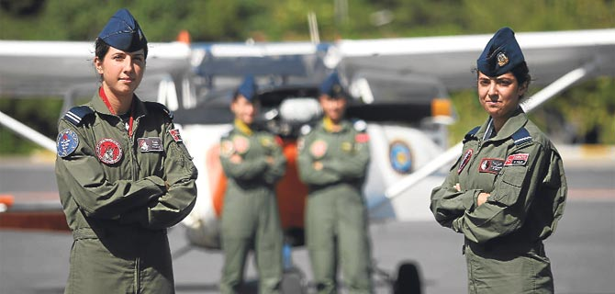
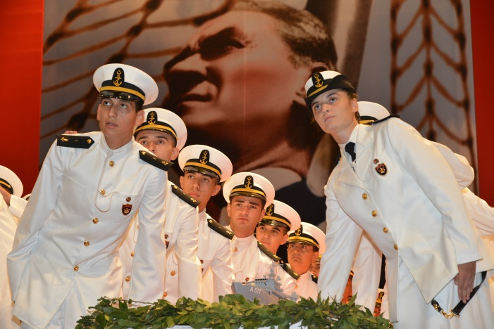
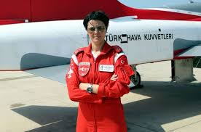
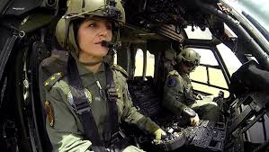
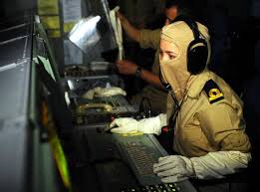
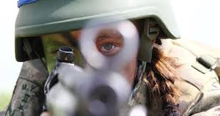
Employment Chain of Female Personnel

Slide 10
Some restrictions
No female personnel is employed in the following branches:
Armour
Infantry
Submarine

Slide 11
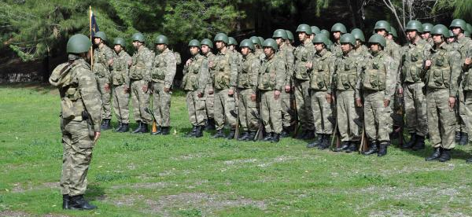
Career Development
Professional Improvement Program for the Female Military Personnel
Officers
Basic Professional Improvement Stage
NCOs
Basic Professional Improvement Stage
Advanced Professional Improvement Phase
Final Professional Improvement Stage
Advanced commandership and Managership Stage
Advanced Professional Improvement Phase
Final Professional Improvement Stage

Slide 12
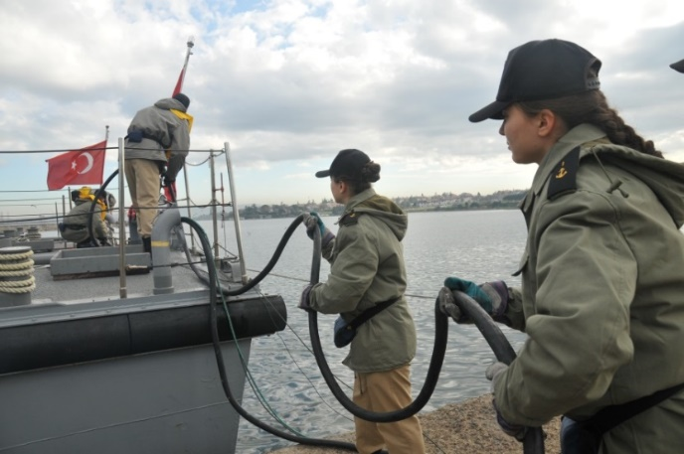
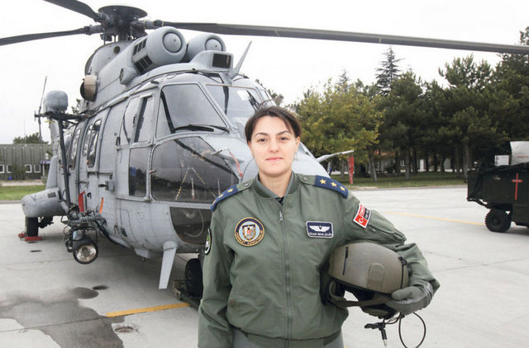
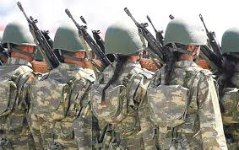
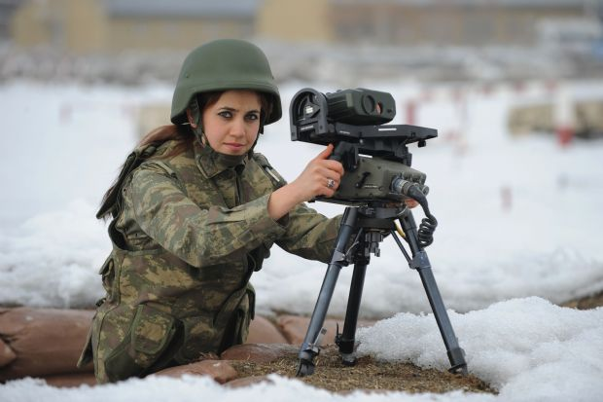
Main Policies & Practices
Both officers and NCOs can be posted in
combat troops
combat support troops
combat service elements
various HQ-level duties

Slide 13
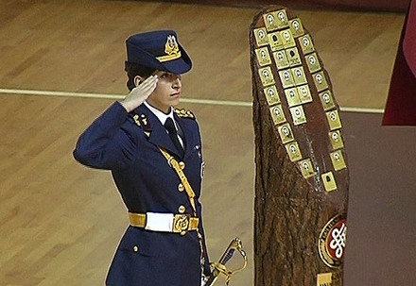
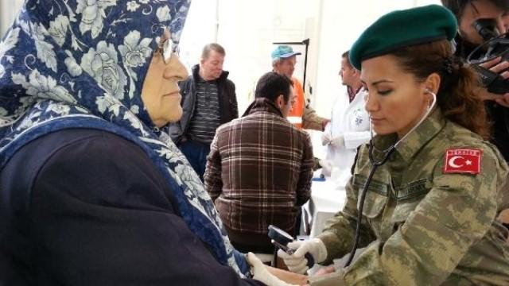
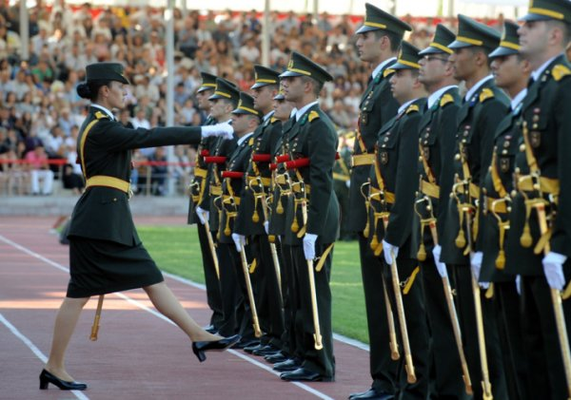
Main Policies & Practices
They can also be employed in
military schools,
military hospitals,
military training centres,
recruitment units,
military maintenance units

Slide 14
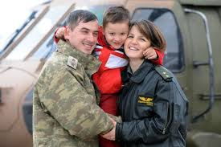
Female personnel in TAF...
can enjoy the full rights that their male counterparts have,
are given additional rights of leave of absence for pregnancy and maternity,
can take unpaid leave for up to 4 years if their spouse is appointed to a permanent duty in a foreign country with the aim of protecting the unity of family.

Slide 15
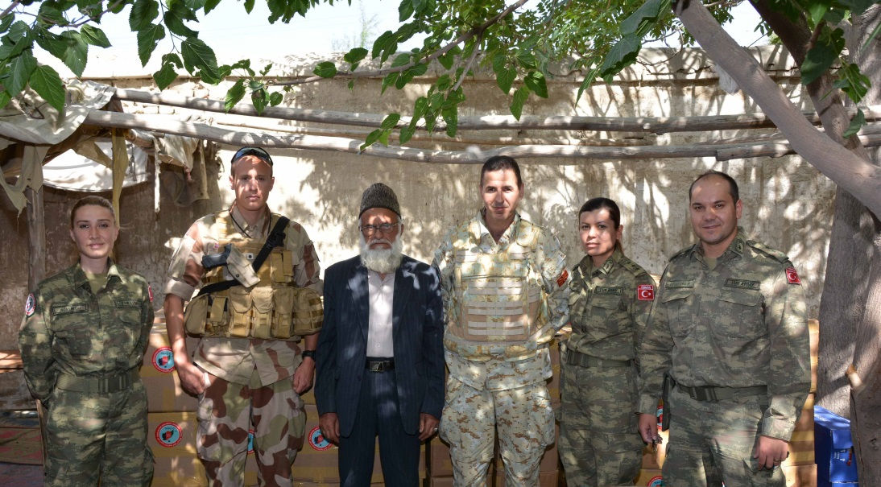
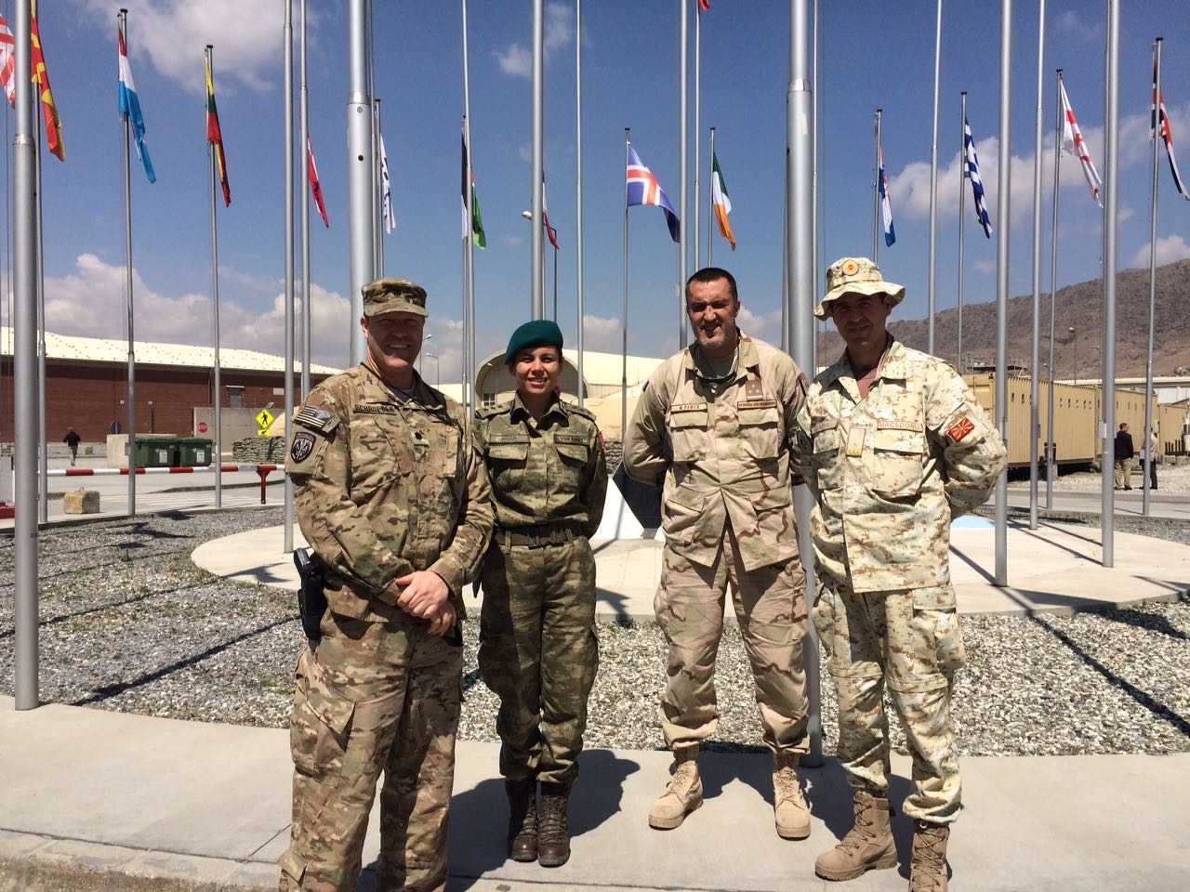
International Peacekeeping Operations & NATO missions
In all International Peacekeeping Operations & NATO missions, female personnel (e.g.: military officers and nurses) can be deployed along with their male counterparts, without any gender discrimination.

Slide 16
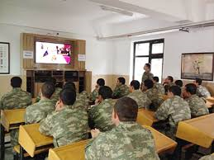
Gender Perspective Training in TAF
CIVIC Training for the Conscripts (supported by EU) aims to provide content and materials prepared in a video-supported training format to conscripts on
legal empowerment
fundamental human rights
women’s rights and gender equality
children’s rights
For the details, you can watch the video of this training with English subtitles:
«MIYE Projesi Tanıtım Filmi»
https://www.youtube.com/watch?v=DhjXYIsGkEo

Slide 17
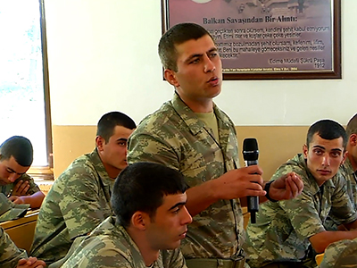
Gender Perspective Training in TAF
The contents of the training for the conscripts include:
TOPIC-1: Women and Education
TOPIC-2: Women and Economic Life
TOPIC-3: Women and Legal Equality
TOPIC-4: Violence against Women
The project aims to help conscripts become responsible and sensitive individuals of the society through this training.

Slide 18
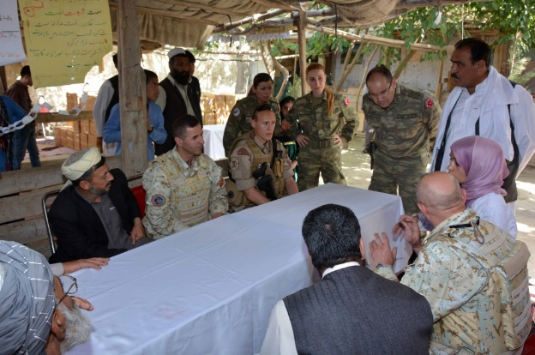
Gender Perspective Training in TAF
There is also an ongoing project of «Gender Advisor» in Peacekeeping Missions.
Since January 2015, there is a full-time Turkish GENAD in RSM Kabul/Afghanistan.
Topics addressed by GENADs:
Logistical activities as to obtaining proper facilities and equipment,
Positions,
Recruitment and training. Operations Planning Process
Gender Analysis
  Factor Analysis
  Operational Risk Evaluation
  Rules of Engagement
  Commander’s Critical Information Requirements
  Standards of Behavior, Code of Conduct
  Initial Force/Capability Requirements
  Operational Design and Assessment

Slide 19
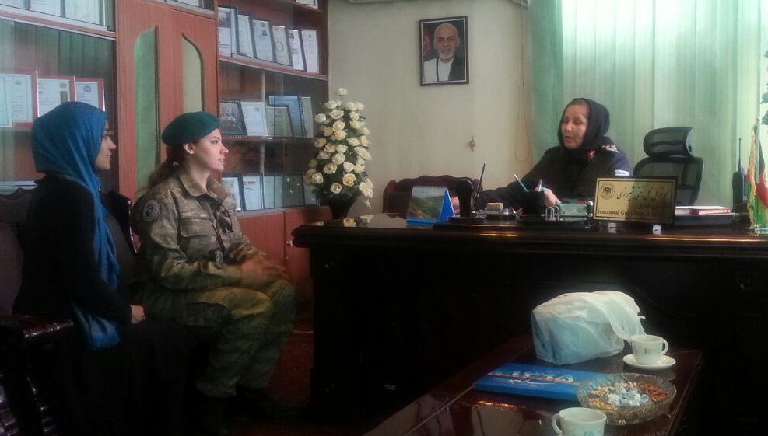
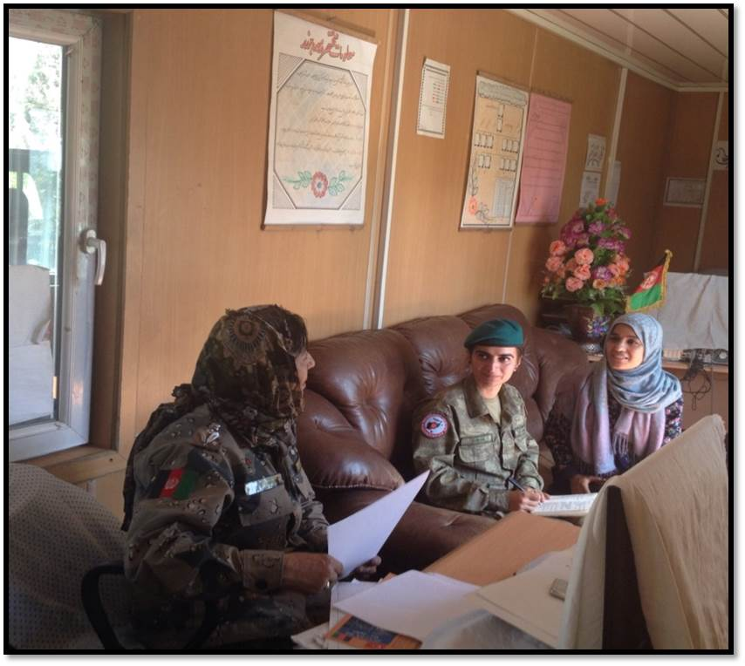
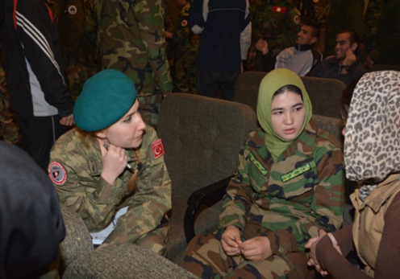
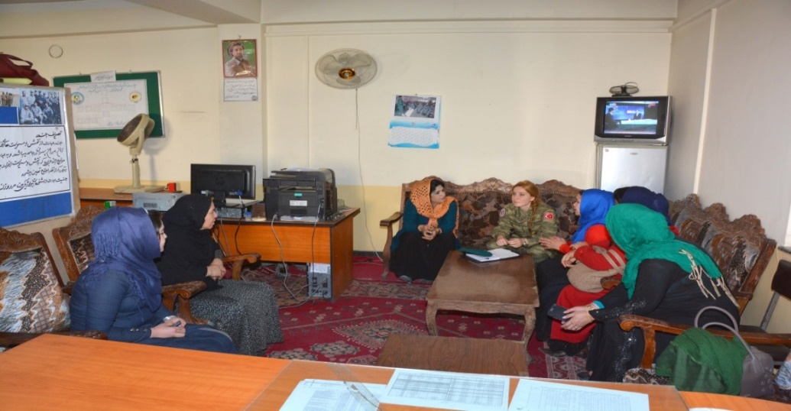
Gender Advisors on Duty

Slide 20
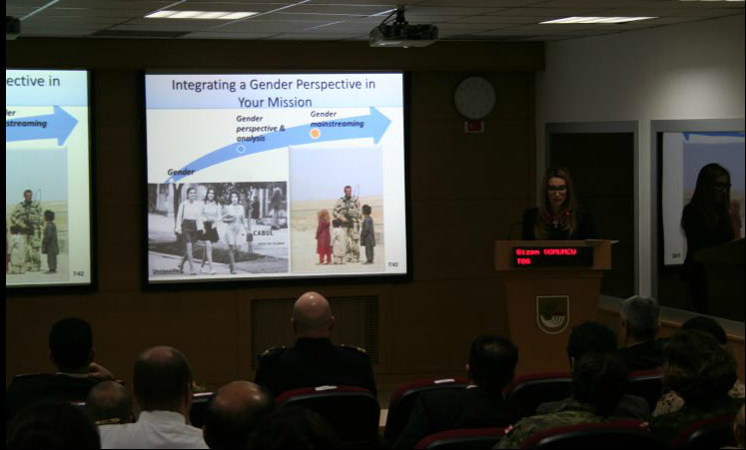
Gender Perspective Training in TAF
Gender awareness training for deployed personnel in peacekeeping operations
Gender awareness workshops

Slide 21
CONCLUSION
GOALS
Improving the employment of the qualified female officers and NCOs,
Having more female personnel in all the task fields, including the combat offices, without any gender discrimination,
Sustaining harmony among female and male officers and NCOs,
Having more female personnel in senior positions,
Increasing awareness on gender issues,
Having «Gender Advisor» positions in every HQ.

Slide 22
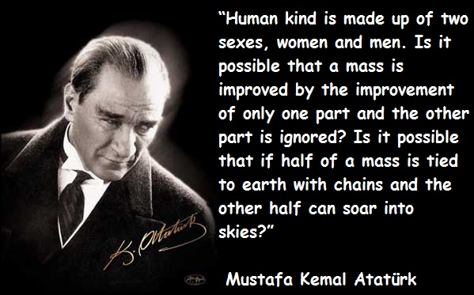

Slide 23
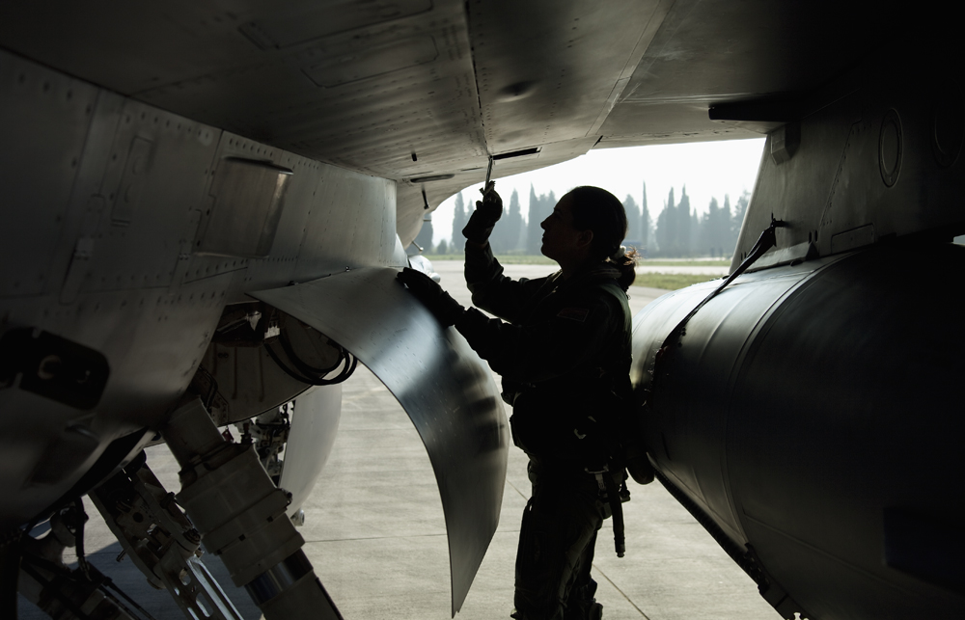
THANK YOU FOR YOUR ATTENTION
Q/A

